Slide 1


Slide 2


Slide 3




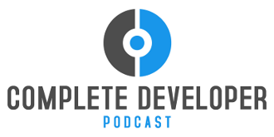



DevSpace would like to thank our sponsors

Slide 4

Who Watches the Watchmen?
Introducing a better metric of your tests’ quality
Matthew Knowles
Software Craftsman at Greater Sum
www.GreaterSum.com
@MatthewYKnowles
Matthew.Knowles@GreaterSum.com

Slide 5
Tests
Notes:
Before we get into the details of mutation testing I would like to zoom out so we can understand where it fits in an agile software development process. We are going to start with tests why do you write them?

Slide 6
Why Write Tests?
Verify functionality
Defend against unexpected change
Executable documentation of the code
Notes:
These are generally the reasons I hear for writing tests. Today we are going to focus on tests that defend against unexpected change.

Slide 7
How frequently do you deploy to your customers?
Notes:
How often does your company deploy your code to your customers? Raise your hand if it is more often than every month. How about every week? Every day? Every commit? Which is essentially Continuous Deployment.

Slide 8
What would make you comfortable with Continuous Deployment?
Notes:
So that everyone is on the same page with terms, continuous deployment is deploying every commit to your customers. Normally its to a small percentage of customers at first and then ramp up over time if no issues. Companies that famously do this are Amazon and Netflix. Continuous deployment might seem extreme for your company but it’s a worthy goal to aim for. What tools would you need to do continuous deployment at your company? There are a lot of things you need to do before a company can implement continuous deployment, source control, build server, infrastructure as code, and test automation. Today I am going to just focus on test automation and its benefits.

Slide 9
Test Automation
Notes:
Which brings us back to tests or more specifically automatically sending our code through a rigorous set of automated tests so we can rely less and less on manual testing and be more confident deploying the code to the customer, as long as it passes all of the tests. As we rely less and less on manual testing this really calls into question the quality of our tests.

Slide 10
Test Quality
Notes:
How do you know how good your tests are? How confident are you that mistakes in the code will get captured by your tests? Do you currently have a way to measure your test quality? A lot of companies would say code coverage is their metric of test quality.

Slide 11
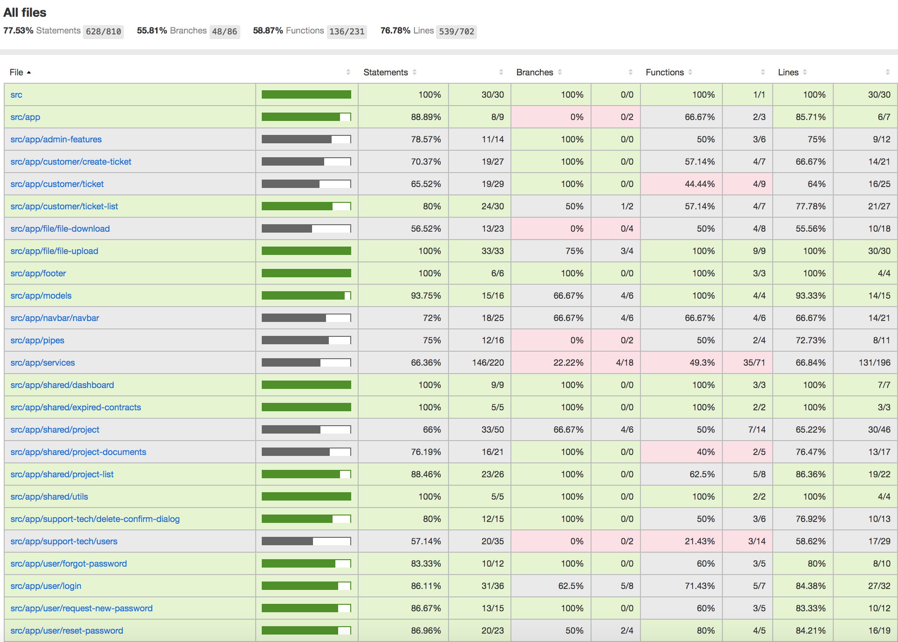

Slide 12
How is code coverage calculated?
Notes:
Does anyone know how code coverage is calculated? What does it mean to have 100% code coverage?

Slide 13
What does this tell you about the quality of your tests?
Notes:
I will get into some of the shortcomings of code coverage with a coding demo in a second but I want start off with something that code coverage does really well. The way that I use code coverage at my company is not to know what code already has high quality tests but instead as an indicator of what code is not tested. If I have code that is 80% covered then I know for sure that 20% of the code does not tests verifying the logic.

Slide 14
Does high coverage give you confidence to change your code and deploy it to a customer?
Notes:
Does having high coverage itself give you confidence to deploy to your customer?

Slide 15




Add functionality to legacy code
Code Coverage
Limitations of Code Coverage
Mutation Testing
https://github.com/MatthewYKnowles/dev-space-2018.git

Slide 16
How would you mutate this code?
1. a < b
2. a || b
3. a == b
4. if(a > b) {return a+b}
5. if(b > a) {a++}

Slide 17

Installing and Running StrykerJS
npm install -g stryker-cli
stryker init
stryker run
https://stryker-mutator.io/stryker/quickstart

Slide 18
Mutation Testing - sounds awesome, why have I never heard of it?
Notes:
Mutation testing has been around for a while but not many have heard about it mainly because it has always been very expensive to run. For each mutation you have to rerun your entire test suite. Two things have made mutation testing more realistic as a tool. 1.) Hardware speed and number of cores. If you guys saw whenever I ran Stryker 8 instance of chrome opened to simultaneously run tests, one for each core. 2.) A new strategy for mutation testing where you run coverage first to see which tests hit a certain line of code and then only run those tests for that mutation, not every test.

Slide 19
When to run Mutation Testing

Slide 20

As hard-nosed as I am about TDD as a necessary discipline; if I saw a team using mutation testing to guarantee the semantic stability of a test-after suite; I would smile, and nod, and consider them to be highly professional. (I would also suggest that they work test-first in order to streamline their effort.)
-Robert Martin (Uncle Bob)

Slide 21
Mutation Testing Frameworks
JavaScript – Stryker
Java – PiTest
C# - Visual Mutator, Stryker

Slide 22
Questions?
Further Reading:
Filip van Laenen – Mutation Testing: Better Code by Making Bugs
Martin Fowler – Refactoring
@MatthewYKnowles

